Slide 1
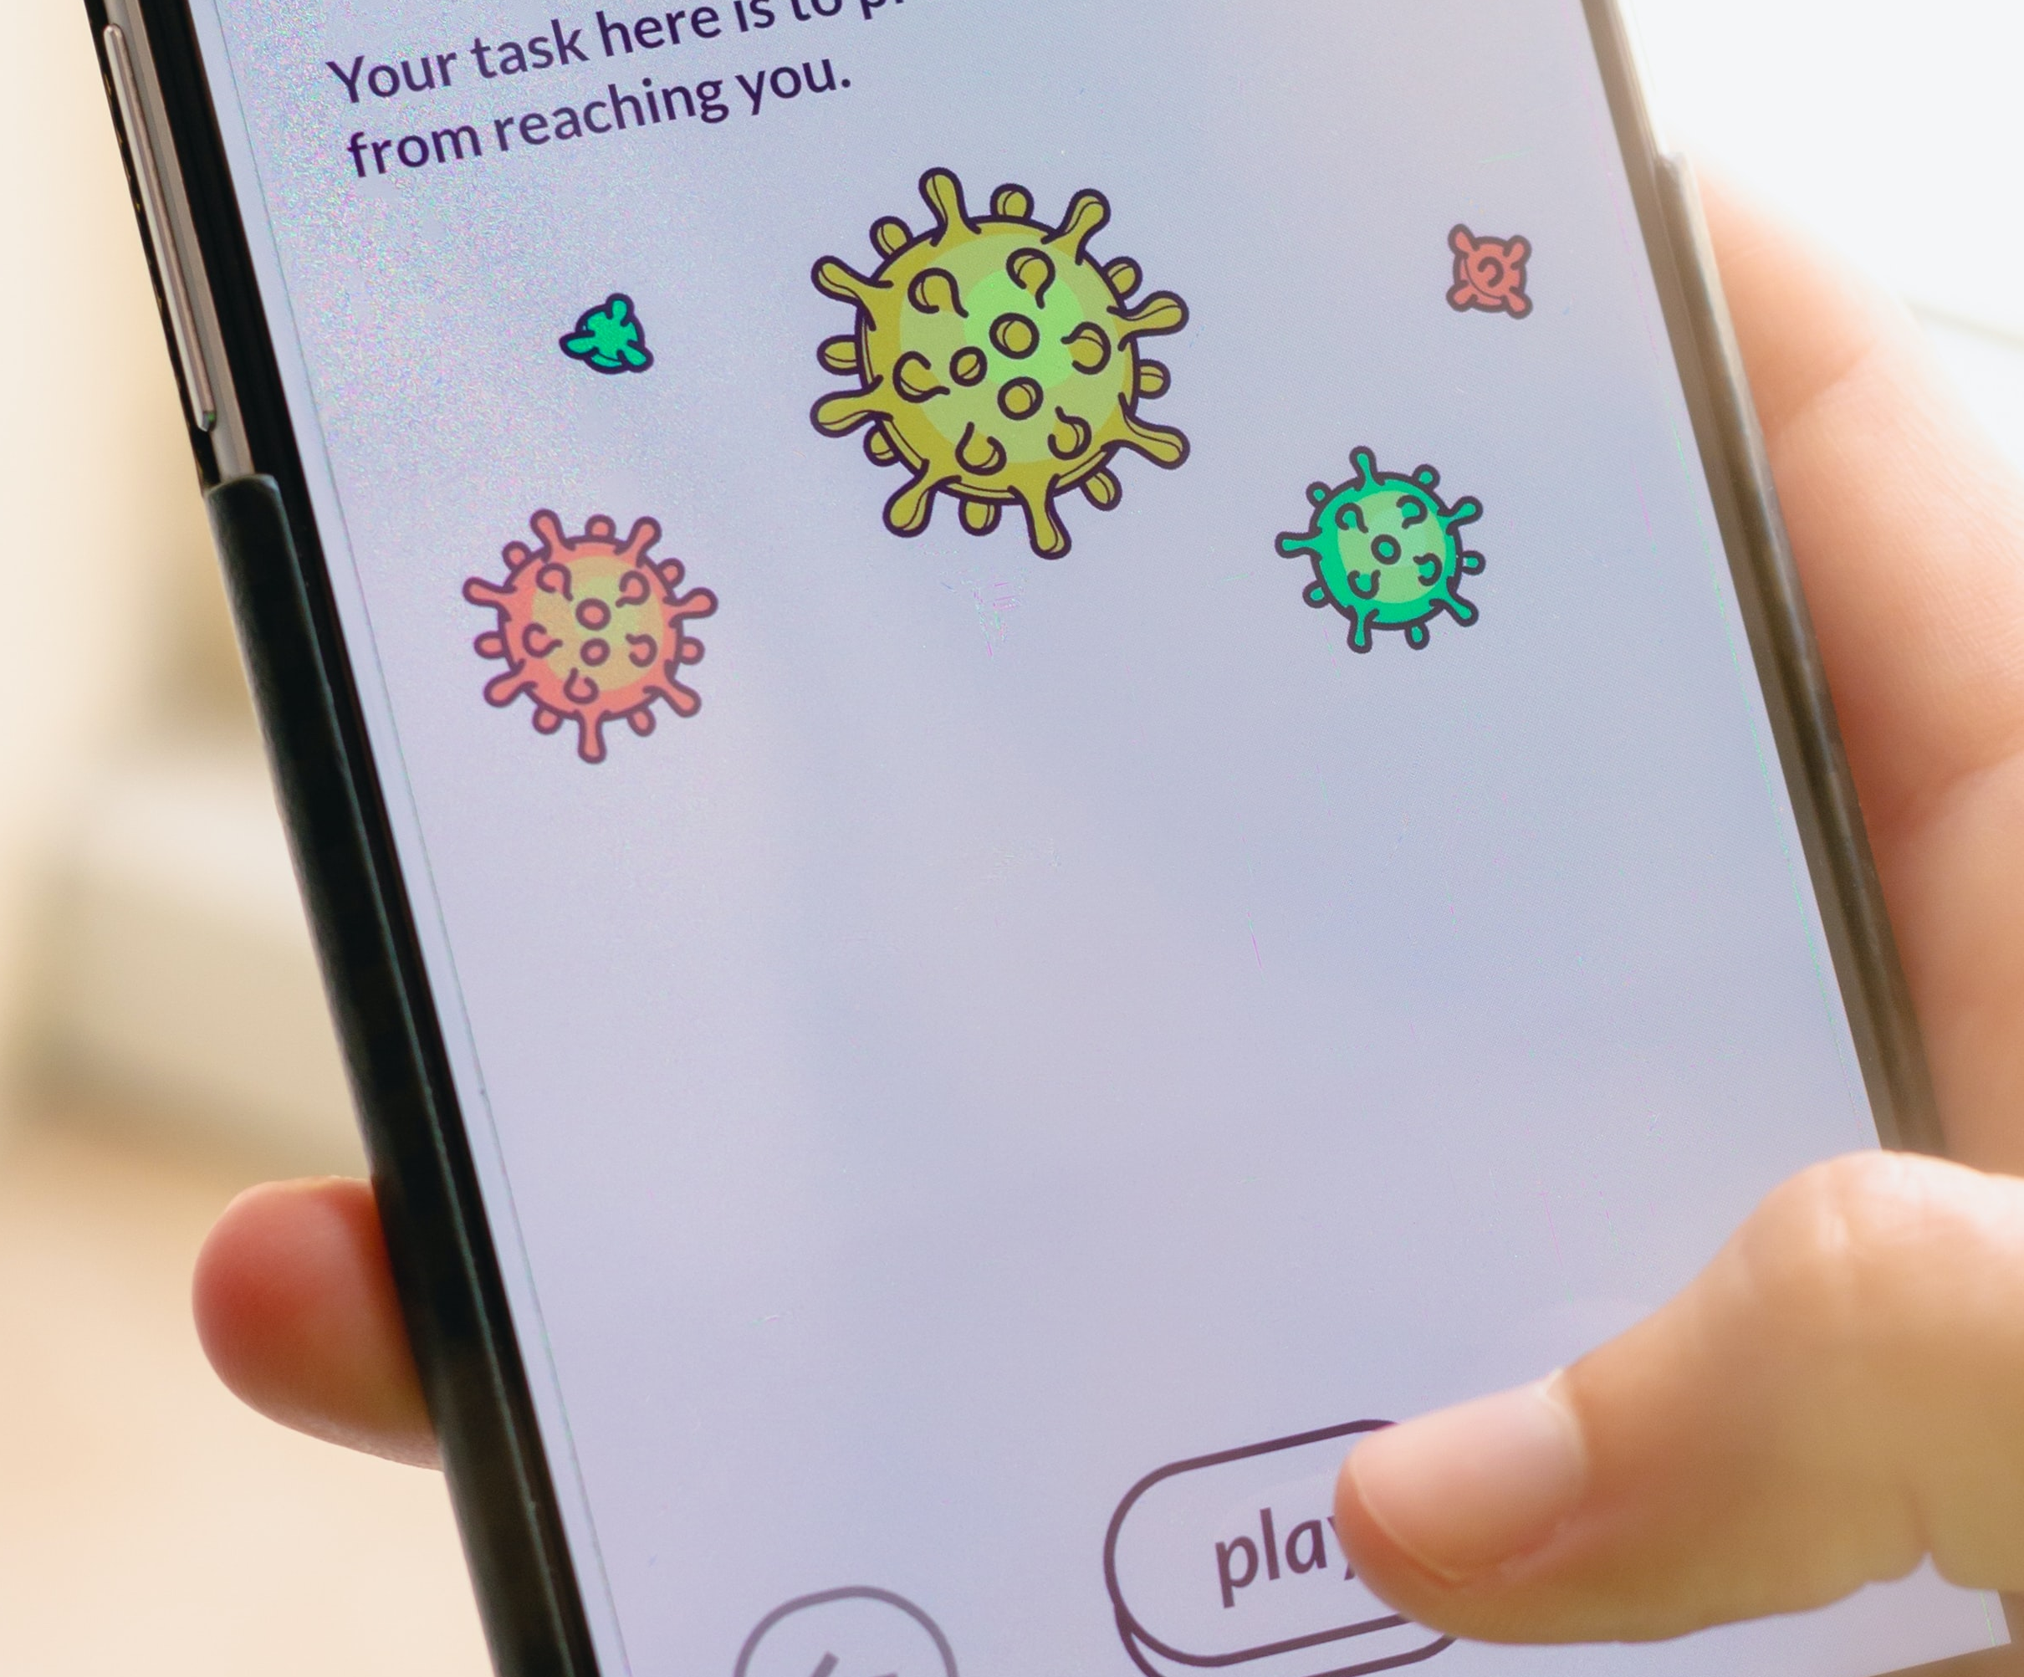
Our Digital Archives of COVID-19
Ian Milligan (University of Waterloo)
Notes:
I am speaking to you from Waterloo, Ontario, on the traditional territory of ‎ the Neutral, Anishinaabe and Haudenosaunee peoples.

Slide 2
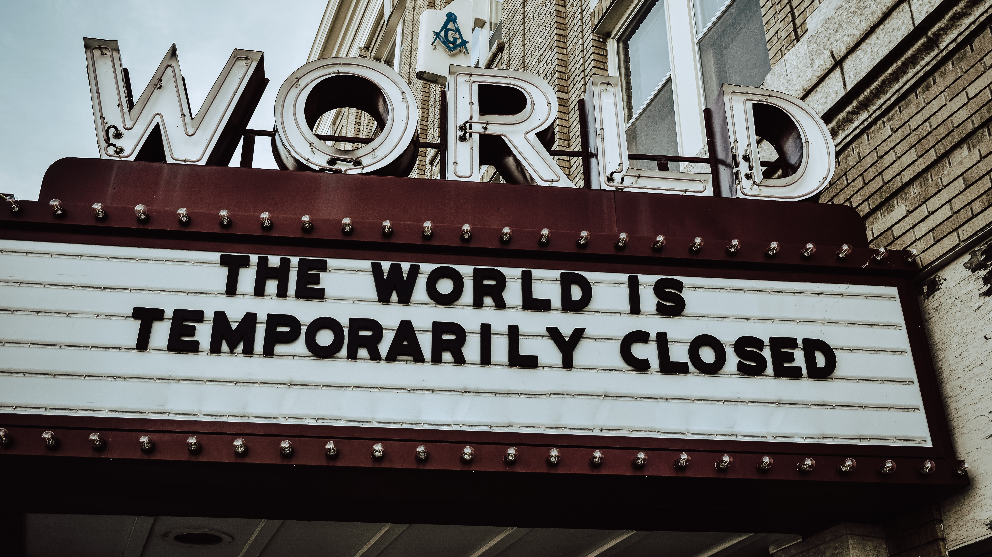
What will our history of the pandemic look like in a quarter century?
Notes:
As a historian, what concerns me is: What will our history of this unprecedented period look like in a quarter century? As the world is reshaped by COVID-19, it’s clear that this pandemic of 2020 and 2021 - let me be optimistic - for future historians to make sense of.
In other words, a child today will be a historian of this pandemic in the future. What sources will they turn to? How will they verify scattered memories? How will people tell the story of the tumultuous times that we’re living in today? And of course, the record we leave behind will be digital in manner.

Slide 3
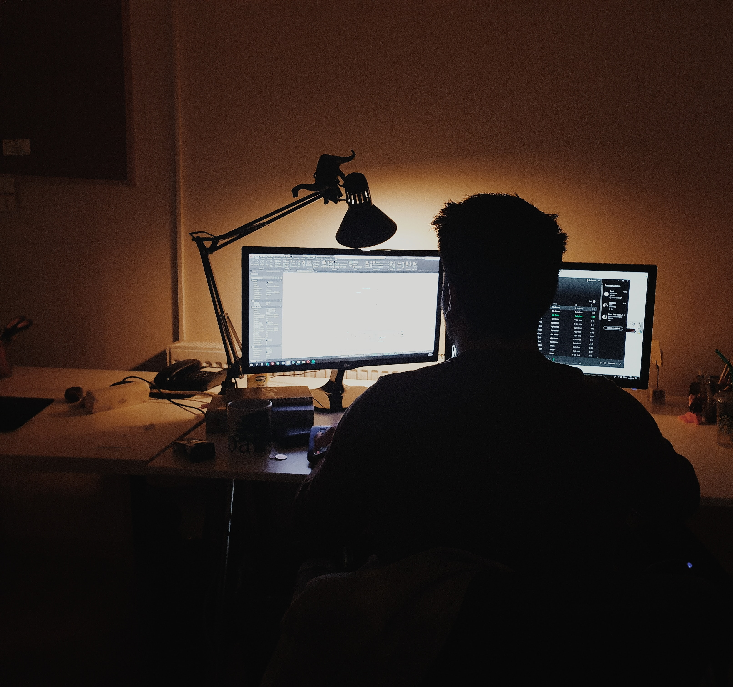
2020/21 Will be Understood Through Digital Media
We connect with loved ones via e-mail, video conference, and social media;
White collar workers have overwhelmingly transitioned to remote working;
Global protest movements have been spurred by digital communication and images;
For some of us in the pandemic, the enduring image may well be a screen.

Slide 4
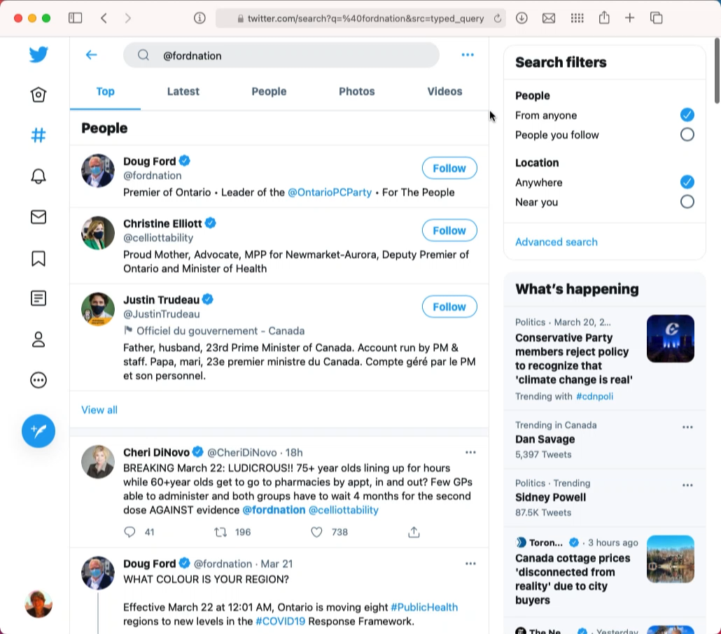
Understanding the Pandemic
Notes:
And, of course, much of this is all mediated through social media. For example, here's what people were talking about on Doug Ford a few days ago on Twitter.com.
<narrate>

Slide 5
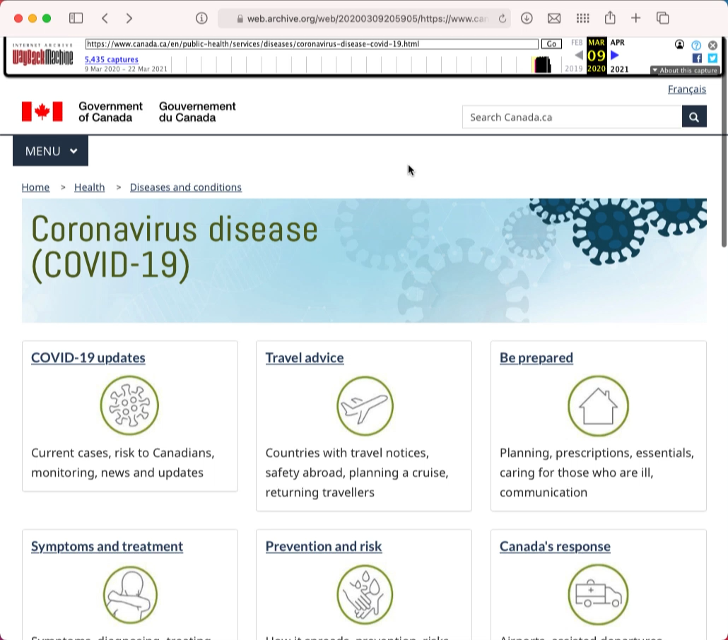
Understanding the Pandemic
Notes:
We can even use web archives - in this case collected by the Internet Archive in San Francisco - to go "way back" in time to a year ago, when the "risk to Canadians" was still low; something that is currently being dealt with in Ottawa.

Slide 6
Why did I have to go to an American website to see our heritage?

Slide 7
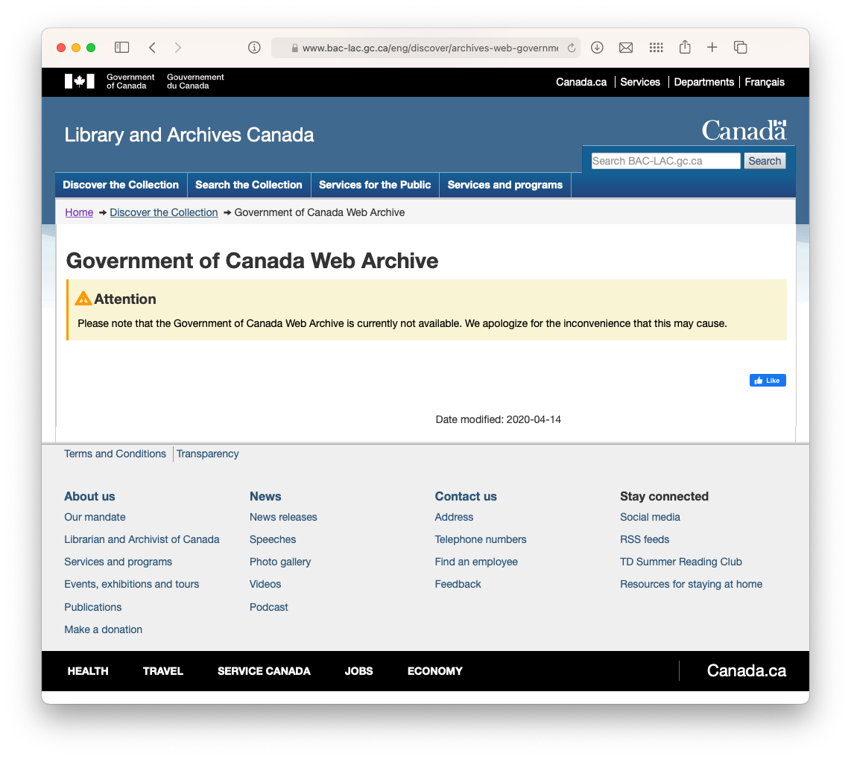
Around the world, national libraries collect digital heritage
In countries as varied as France, Denmark, Singapore, South Korea, Australia, and the United Kingdom, web content all falls into the realm of legal deposit
In the United Kingdom, for example, a researcher will be able to view millions of pages from news websites, UK blogs, and beyond.

Slide 8
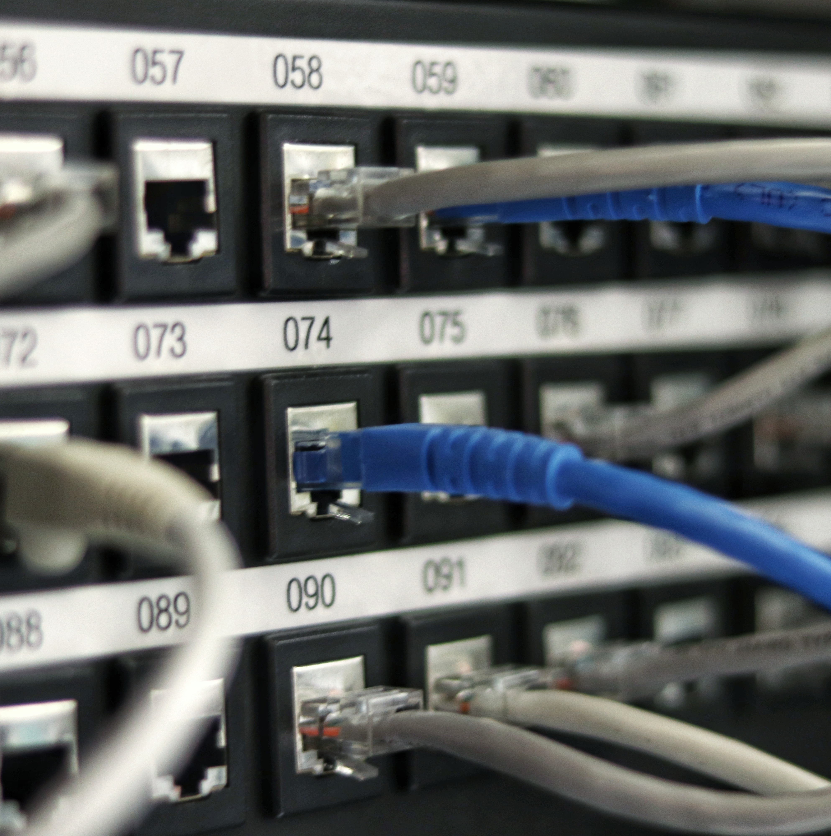
In Canada
The Library and Archives Canada Act (2004) is fantastic and gives the national memory institution the power to gather a “representative sample of the documentary material of interest to Canada that is accessible to the public without restriction through the internet or any similar medium.”
We just don’t use it to its fullest extent.

Slide 9
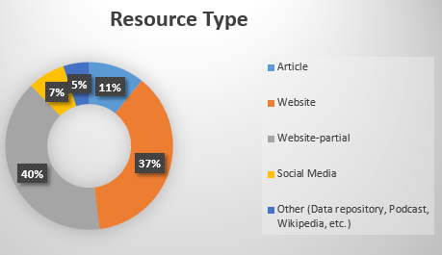
That’s not to say LAC doesn’t do amazing things..
Since February 2020, have crawled some 6.2 TB of data and collected 721,651 tweets in both official languages.

Slide 10
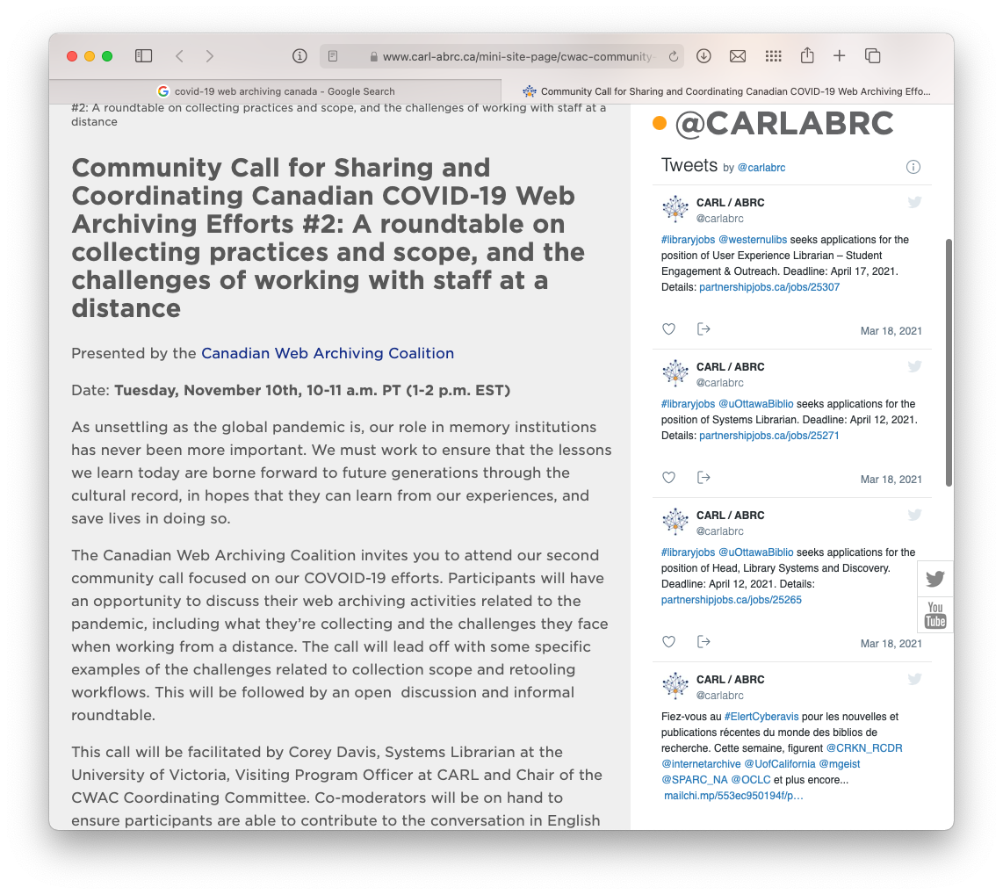
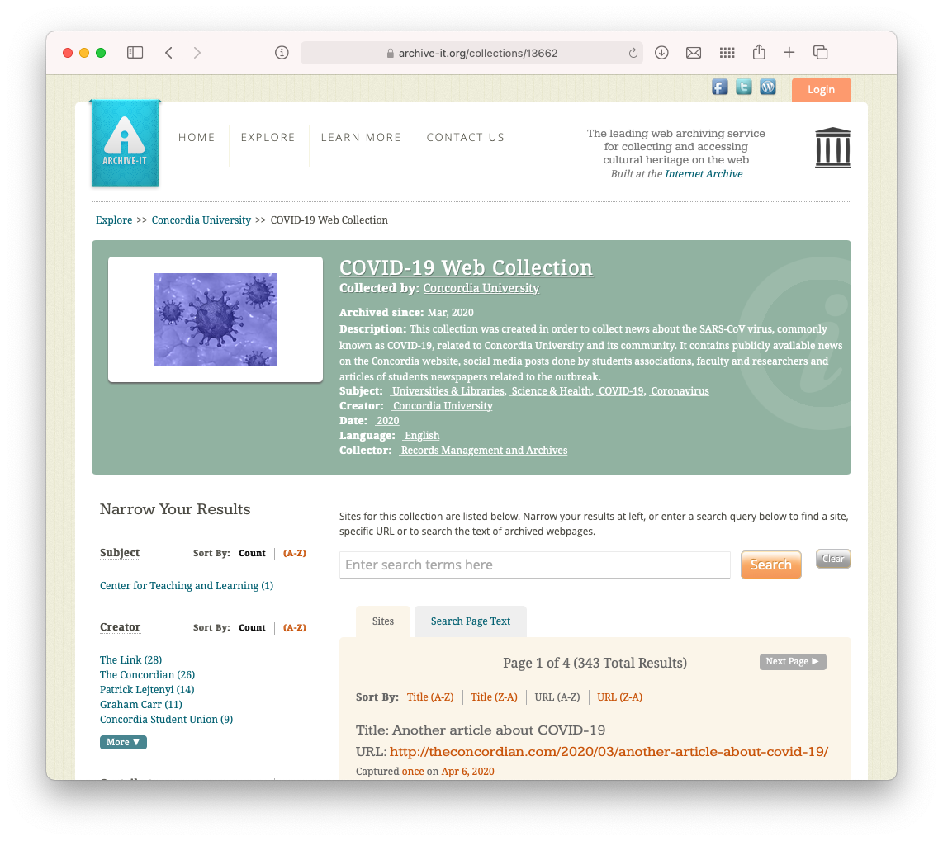
… and that institutions around the country haven’t been digitally archiving these events!

Slide 11
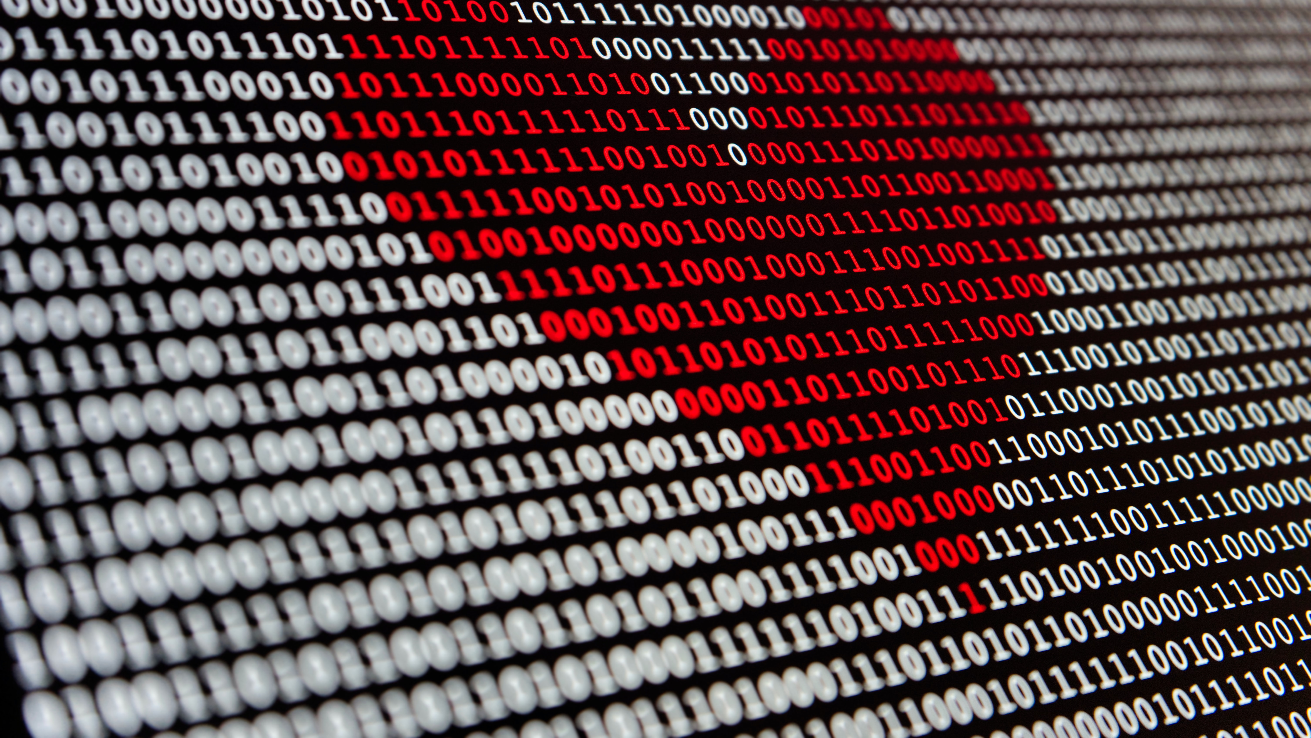
But we need to do a bit more.

Slide 12
A Born-Digital Preservation Program
When we survey people about web archiving, people are in fractions of jobs – 10% or 20% of a person’s time – to do digital collecting which is an overwhelming amount of time
We need funding from the Government of Canada to specifically fund this capacity across our cultural heritage sector.
Notes:
Our calsl then were.
No more robbing Peter to pay Paul.

Slide 13
Empower our Library and Archives Canada
Empower and fund LAC so they can begin to both preserve the entire Canadian World Wide Web and retain it on sustainable, Canadian digital infrastructure
Data sovereignty matters.
LAC can also help coordinate activities happening across the country – some things are undoubtably being collected by many; other things are falling within the crack.

Slide 14
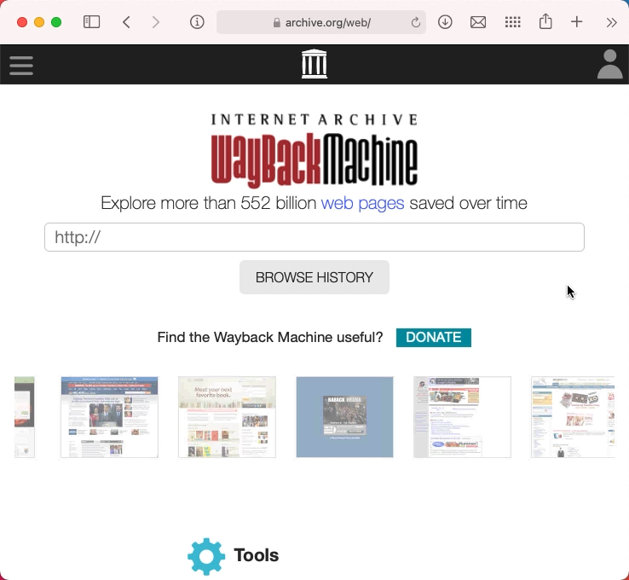
Empower our Citizens
You can go to the Internet Archive and provide a web site to be saved now via “Save Page Now”
Why can’t we have something similar here? A crowdsourced archive of COVID-19?

Slide 15
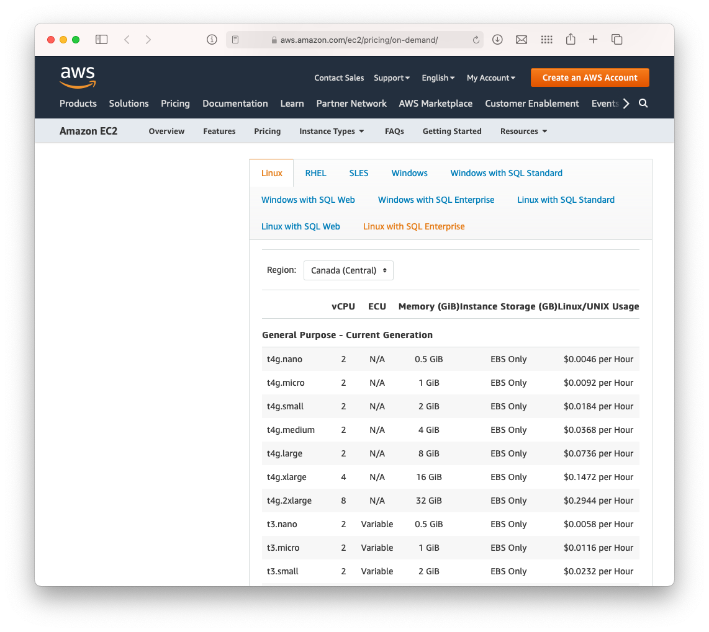
Facilitate Cloud Storage in Canada
Lots of memory institutions across the country have their data housed in American data centres
If we care about our digital cultural heritage, lets make sure it sits in Canada.

Slide 16

It costs money, but our digital cultural heritage is currently preserved on a shoestring.

Slide 17
As we rebuild and recover from COVID-19, let’s make sure we have a robust memory to inform our future decisions.

Slide 18
Thank you! Ian Milligan i2millig@uwaterloo.ca

